Slide 1
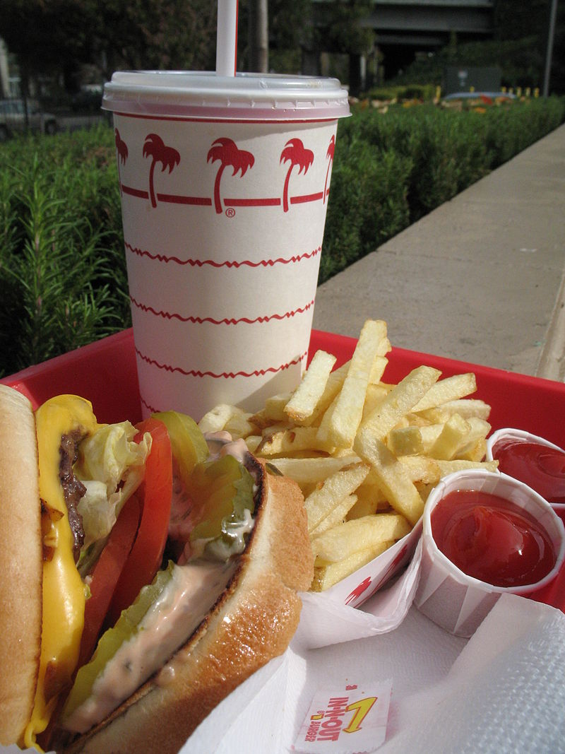


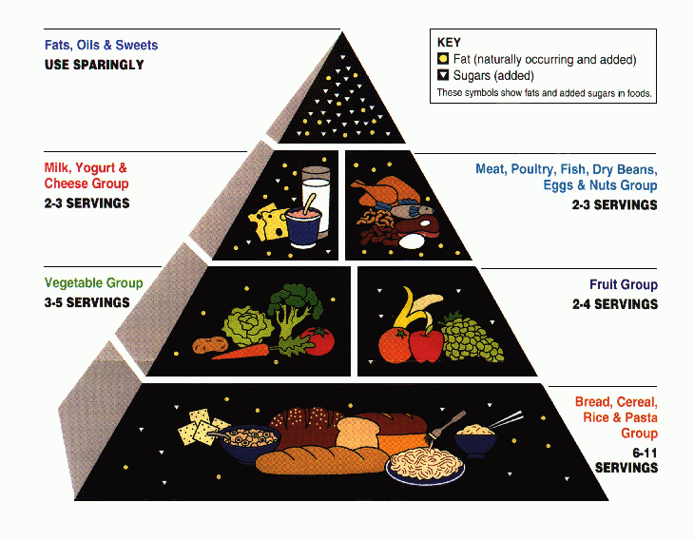
$
Burger cost + … = Total Cost
Objective: Save money!
Subject to: Nutritional concerns
Hamburger,
fries,
etc
Objective: minimize cost
Subject to: (Nutritional concerns):
Cost function
Variables:
OPTIMIZATION

Slide 2
Objective Function
LINEAR
No
Yes
Decision Variables
Yes
Decision Variable
Si
No
No
Linear Programming
Mixed Integer Linear Programming
Non Linear Programming
Mixed Integer Non Linear Programming
SIMPLEX
Branch
& Bound
KARUSH, KUHN, TUCKER
Outer Aproximation

Slide 3





Slide 5











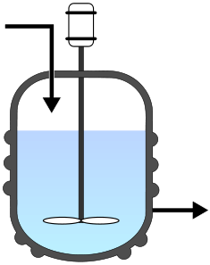
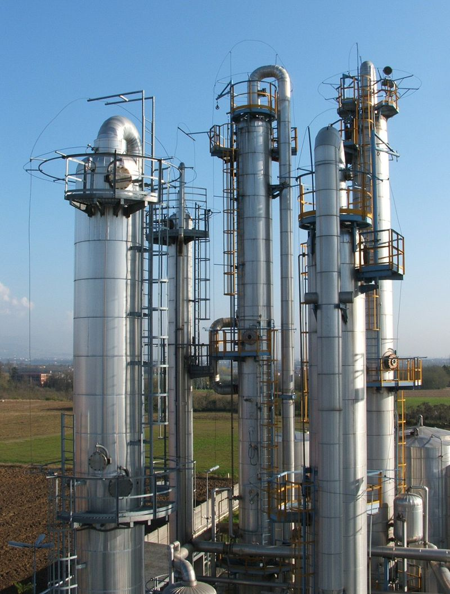
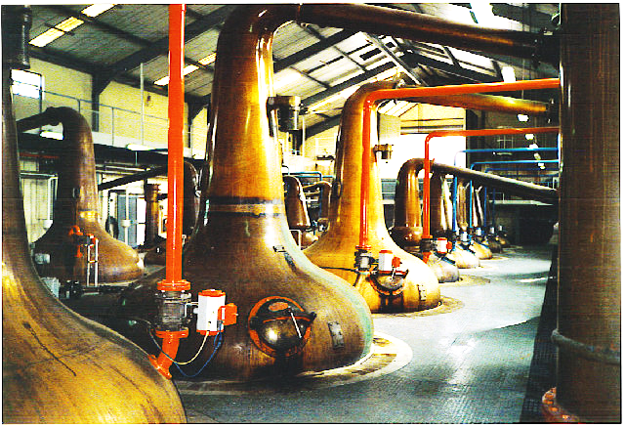
Chemical engineering in a nutshell:
.org
water
+
malt
+
Water waste
(don’t drink this)
hops
yeast
beer
Whisky
(Chemical) reactor
Distillation
or
or
batch
(alembic)
batch
continuous
continuous
(distillation column)

Slide 6
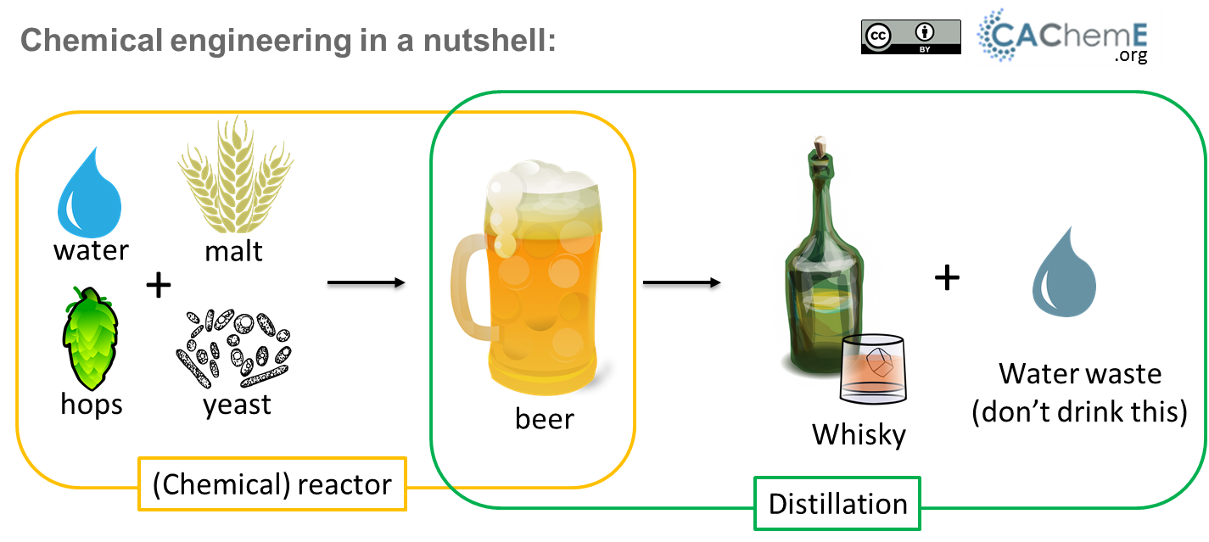

Slide 7
